Slide 1

The Maharaja Sayajirao University of Baroda
Dual axis solar tracking system with weather sensor
Under Supervision of Prof. TEJAS PATEL
DEPARTMENT OF ELECTRICAL ENGINEERING
NAME OF STUDENTS
BHUMI PARMAR (2019033800109405)
ANJU BARIYA (2019033800115472)
ISHALI HEMAN (2019033800115874)
ARYAN JADAV (2019033800108391)

Slide 2
INTRODUCTION
Global warming has increased the demand and request for green energy produced by renewable sources such as solar power.
A Dual-axis tracker can increase energy by tracking sun rays from switching solar panel in various directions.
This dual axis solar tracker project can also be used to sense weather.

Slide 3
BACKGROUND STUDY
Solar energy being green, renewable source of energy, should be tried to get the maximum output from and used in different ways.
The most common and easiest ways is using photovoltaic cells, which will directly convert solar energy to electricity.
Today, electricity from solar cells has become cost competitive in many regions and photovoltaic systems are being deployed at large scales to help power the electric grid.

Slide 4
PRESENT TECHNOLOGY
A solar panel in a fixed orientation will lose 75% of the energy in the morning and evening.
Rotating the panels can help recapture these losses.
Single-axis solar trackers rotate on one axis moving back and forth in a single direction.
While the modern dual axis solar tracker tracks east west and north south movement of the sun.
It captures the solar energy more effectively by rotating its axis along vertical and horizontal axis.

Slide 5
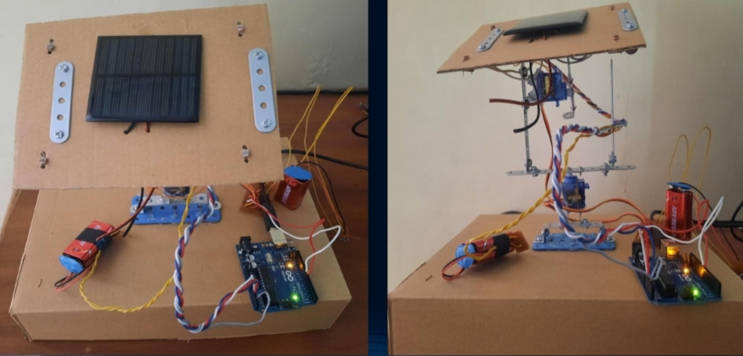
PROTOTYPE

Slide 6
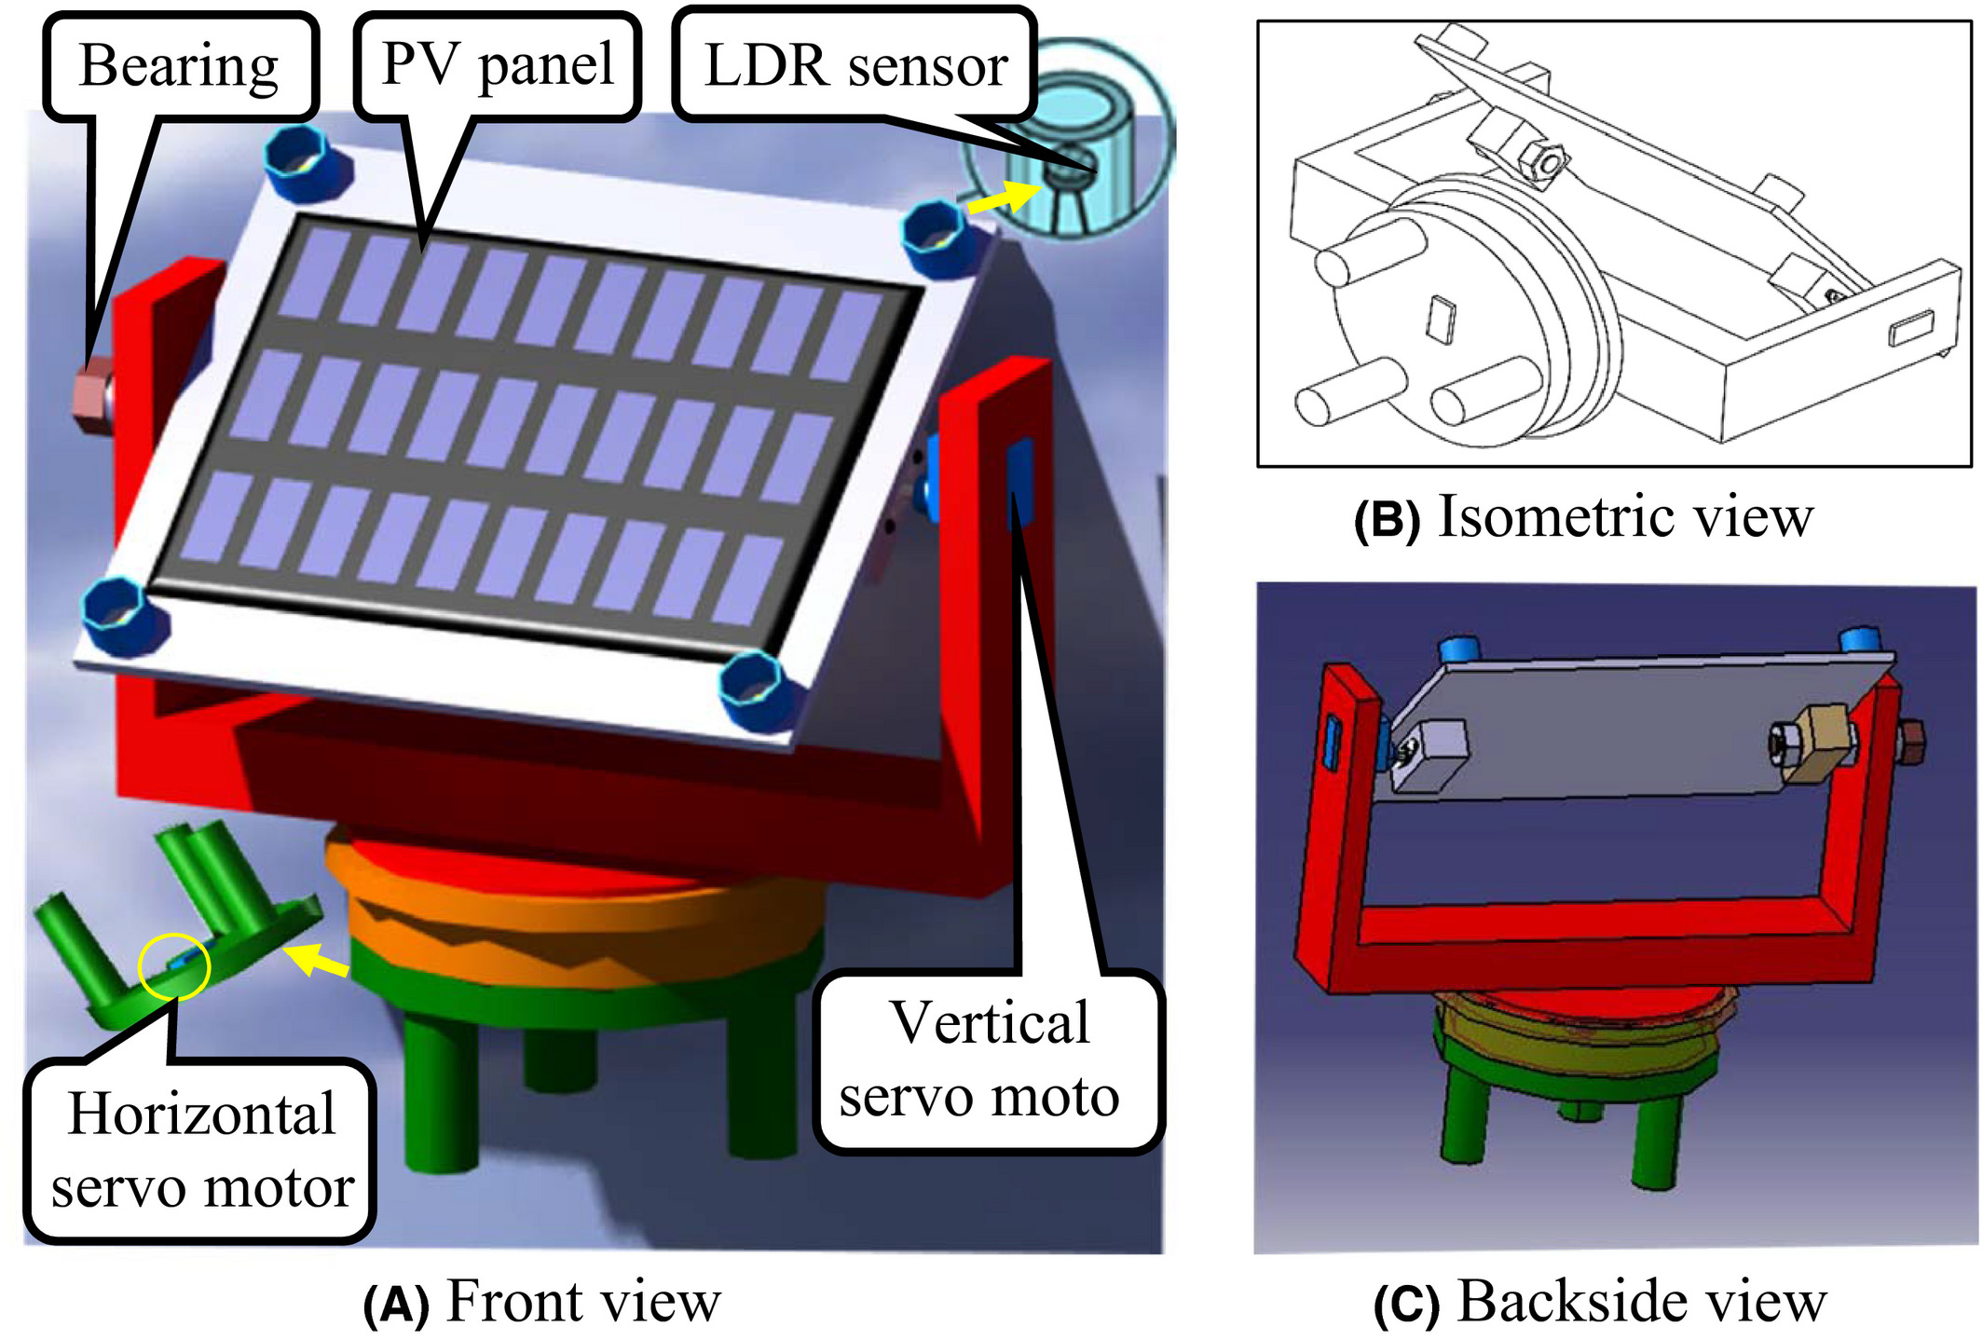
WORKING PRINCINPLE
The system is divided into four different units:
1. Sensing unit- The LDR sensors sense the light and sends signal to microcontroller.
2. Control unit- The microcontroller, according to the developed program code, processes the received information to dc servo motors.
3. Movement adjustment unit- The dc servo motors drive the solar panel in horizontal and vertical direction.
4.The weather sensing unit which indicates the surrounding temperature conditions and humidity is displayed on LCD display device.

Slide 7
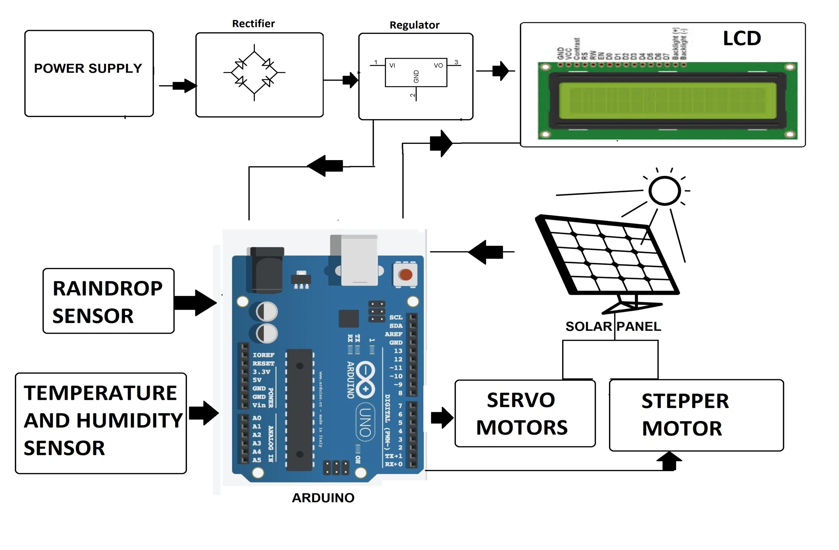
BLOCK DIAGRAM
LDR SENSOR

Slide 8
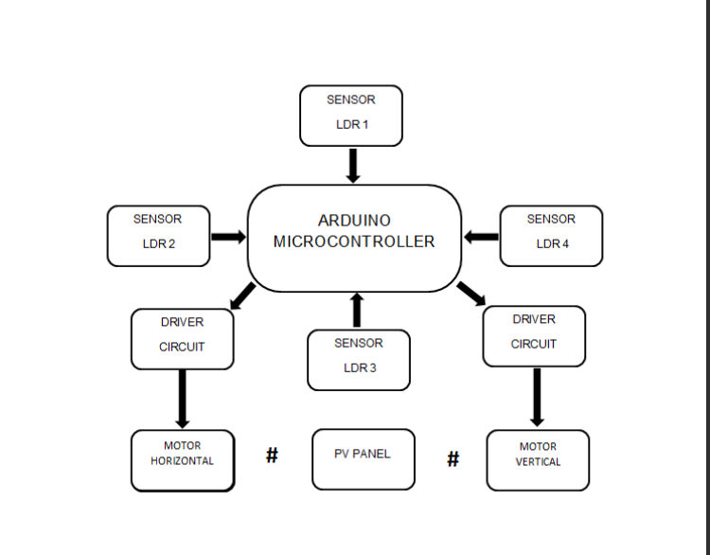
FLOWCHART

Slide 9
HARDWARE COMPONENTS
Solar Panel
Servo Motor(2)
Rain Sensor
Humidity Sensor
Temperature Sensor
Resistor(10k*4)
Capacitors
Transistor
LDR sensor(4)
LED
PCB
Transformer
Frame

Slide 10
RESULT
Dual axis tracker perfectly aligns with the sun direction and tracks the sun movement in a more efficient way
It maximize the energy generation and improve the efficiency 40% more than the fixed panel.
This dual axis solar tracker project can also be used to sense weather

Slide 11
CONCLUSION
The proposed solar tracking system will be reliable and accurate throughout the year and maximize the output power when compare to static system. It will be a good and competitive solution for the market place as it is expected to compete with more complex and expensive system.

Slide 12
FUTURE SCOPE AND ADVANTAGES
Increase accuracy of tracking by using different light sensor.
It can be operated automatically.
For domestic backup power system.
For power generation at remote place where power lines are not accessible.
It can be implemented on large solar plants.
It can be used for solar cookers, ovens, thermal solar heater.

Slide 13
REFERENCES
International Journal of Recent Technology and Engineering (IJRTE) ISSN: 2277-3878, Volume-8, Issue-2S11, September 2019.
International Scientific Electric Power Conference – 2019 IOP Conf. Series: Materials Science and Engineering

Slide 14
Thank you

